Slide 1
Twitter Stream Processing Pipeline
Big Data Project

Slide 2






Meet the Team
MOHAMMED ALI JABIR
YAZAN ASHOUR
MOHAMMED SAYEH
MOHAMMED AMAD
TEAM LEADER
TEAM MEMBER
TEAM MEMBER
INJURED TEAM MEMBER

Slide 3
PROJECT DESCRIPTION
The Tweet Analysis Pipeline is designed to process live Twitter streams for sentiment analysis, trending hashtag identification, and data visualization.
.

Slide 4
SENTIMENT ANALYSIS LIBRARIES
Problems
01
we used libraries like spark NLP and didnt work as expected
In a world with billion of tweets there is a need to analyze the tweets but of course we have faced a lot of problems
VISUALIZATION
02
We got a hard time trying to visualize how we will handle and present that big amount of data we have

Slide 5
Solutions
01
02
Searching for another libraries and solutions
We tried a lot of sketches and tools to help us
we searched for another libraries that also didnt work then we find and used the standford corenlp library
When we hit the wall trying to visualize the application we used some tools like figma and tried to apply it in the frontend

Slide 6



Target Audience
Data Scientists:
Researchers:
DR. Hamed AbdAlhaq
⮚For developing predictive models and analyzing people feelings via there tweets.
⮚For studying public opinion, social movements, or market trends.

Slide 7
How We WORKED
We Decided To Divide The Tasks As Sprints
SET-UP THE WORK ENVIROMENT AND DECIDE HOW WILL WE WORK ON THE PROJECT
FINISH THE PROCCESING ON THE TWEETS AND THE STREAM INGESTION AND VISUALYSE THE PROCCES
START WORKING ON THE STORAGE AND FINISH THE WEB APPLICATION SKETCH AS NEDDED
MODIFY THE IMPORTANT PARTS TO FIT WITH THE STORAGE AND MERGE ALL THE WORK
Sprint one
Sprint Two
Sprint Three
Sprint Four

Slide 8



PROCCES AND ANALYSE THE DATA
EXTRACT IT AND CHANGE ITS TYPE AND KNOW ITS STRUCTURE
PROCCESING THE DATA
SENTIMENT ANALYZATION
NEGATIVE . POSITIVE AND NATURAL

Slide 9
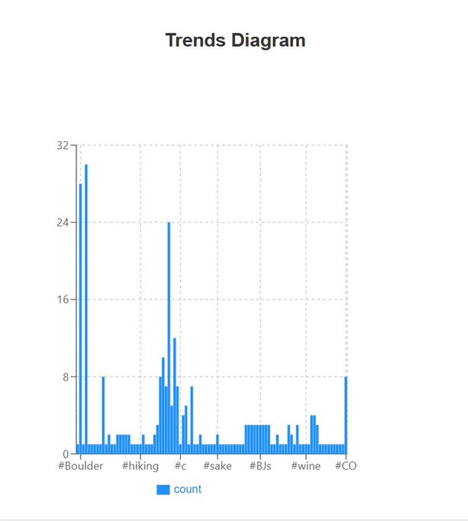
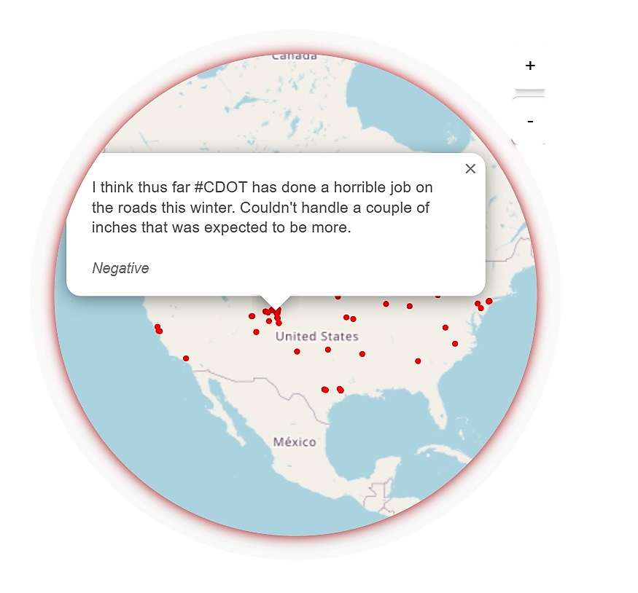
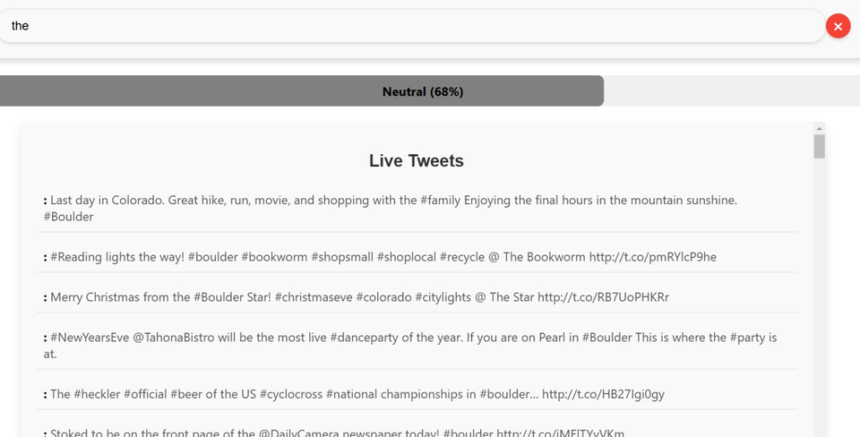
Visualization

Slide 10
TECHNOLOGIES USED
STREAM PROCCESING
STORAGE
VISUALIZATION
MACHINE LEARNING
APACHE KAFKA
ELASTICSREARCH
WEB APPLICATION
STANDFORD CORENLP

Slide 11



KEY FACTORS FOR STORAGE
SCALABILITY
The storage system must efficiently manage the high-velocity flow of Twitter data.
REAL-TIME ACCESS
Enables near-instant querying for analytics and visualization purposes.
RELIABILITY
Guarantees data integrity during ingestion and processing.

Slide 12


STORAGE OPTIONS
Serves as a distributed message broker, providing real-time buffering for data streams.
APACHE KAFKA
ELASTICSEARCH
Handles indexing and storage to facilitate fast search and analytics

Slide 13




Contact Us
0592085729
YAZAN.H.ASHOUR@GMAIL.COM
HTTPS://GITHUB.COM/YAZAN-ASHOUR/BIG-DATA-TWEETS-PROJECT

